Slide 1
When to Commit to an Action in Online Planning
Aya Kherrour

Slide 2
Proposed scheme
Introduces a meta-reasoning scheme for action commitment called Flexible Action Commitment Search (FACS).
focusing a real-time search to gain additional time to search farther ahead in the search tree.
Addresses concurrent planning and execution.

Slide 3
About the paper
Objective:
achieve a goal as soon as possible.
Requirements:
The work requires that the systems remain under control (which means commit to a new action before the previously one ends to make more look-ahead).
Domain Assumptions:
Actions are serials.
The world is completely observable and deterministic. (the environment is deterministic if the next state of the world is solely determined by the current state of the world and the actions selected by the agent).
The planner search for a sequence of actions under the constraint of at least one action (beyond those that have been computed) has been computed, committed to and has begun execution.

Slide 4

Always commit one (Korf 1990)
Fixed number of expansions (or amount of time) to make a look-ahead node expansion.
after it The search must commit to the next action to take and re-root the search tree.
The algo Backup h values from the look-ahead frontier to inform the action choice.
This backup at every node allow the heuristic information to become more accurate over time and probably preventing the search from becoming stuck in infinite loops.
They commit only to one action.
RTA* and LRTA* algorithms
Too conservative

Slide 5

Always commit all (Koenig&Sun 2008, Burns et al 2013)
committing to the entire sequence of actions leading to the most promising frontier node.
reduces the re-generation of nodes seen during the previous lookahead and reduces the overall overhead of the search per executed action.
But commits the agent to certain actions, such as those at or near the frontier, for which little lookahead has been performed (dead-ends)
LSS-LRTA* algorithm
Too risky

Slide 6
Dynamic ˆf algorithm (Kiesel, Burns, and Ruml 2015)
Dynamic ˆf uses the entire time until all the committed actions have finished executing to perform look-ahead search.
The amount of look-ahead is set dynamically, rather than being fixed from the start.
modifies LSS-LRTA*

Slide 7
metareasoning assumptions about the search process:
1. The order of decision in the planner is a fixed search tree structure, from early actions to later actions.
2. No replanning is permitted after action commitment, a decision to commit to an action in the sequence means that it will eventually be executed in the order specified.
3. We may re-start search at a new state if necessary, for example, if the controlled system departs from our assumption of determinism.
4. The only question we address is when to ‘reroot the tree’ at a successor of the root, that is, should we do this before it is necessary?
5. We assume a given expansion strategy that is not modified by the commitment strategy, other than by pruning the parts of the search tree inconsistent with the action commitments.

Slide 8
1. The order of decision in the planner is a fixed search tree structure (from early actions to later actions).
Early action
s1
a3
a1
a2
s1
s1
a8
s1
s1
…
a9
a6
a2
a4
a5
a6
a7
s1
s1
s1
s1
Later action
a9
s1
Order of decision

Slide 9
2.No re-planning after action commitment
a decision to commit to an action in the sequence means that it will eventually be executed in the order specified.
s1
Planner committed to a6
a3
a1
a2
s1
s1
a8
s1
s1
a4
a5
a6
a7
s1
s1
s1
s1
a9
s1

Slide 10
Proposed myopic met-reasoning scheme
It only considers the next action commitment decision. one of the following need to be chosen:
Commit to the action with the best (least) estimated ˆf value among all children of the current root node. We denote the node that corresponds to this action by α.
Do not commit to α yet, and spend more time searching before deciding which action to take next.

Slide 11
Commit to the action with the best (least) estimated ˆf value
turn around eventually
action with the best (least) estimated ˆf value
α
result in a solution with an increased cost.
Dead end
The search algorithm has failed to figured that out before committing
Notes:
Alpha is it the node or the arc ?
committing to α might reduce the quality of the solution.
For example, if α leads to a dead-end and the search algorithm has failed to figured that out before committing, then it would be forced to turn around eventually, which would result in a solution with an increased cost.

Slide 12
Do not commit to α yet
action with the best (least) estimated ˆf value
by gaining additional search time before making consequent decisions the search algorithm might be able to avoid future dead-ends or pitfalls, which would not have been possible to avoid otherwise.
α
Do not commit yet
Make additional search to avoid future dead-ends

Slide 13
The Effect of Committing
Under the next assumptions, we can now estimate the utility of committing to and of not committing to α
1. Each node has exactly two children, α and β, where α is the node with the highest expected utility (lowest expected ˆf-value).
2. The time df required to fully execute an action is identical for all actions;
3. When searching under a node s, the search time is evenly divided among all of its children.
4. The Xd s random variables are independent for all d and s.

Slide 14
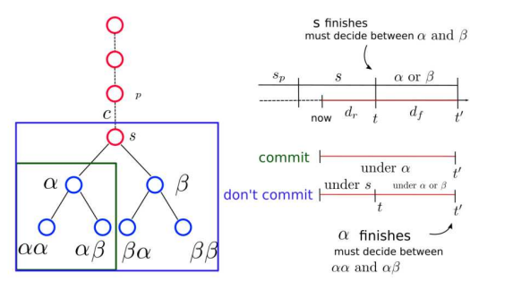
The Effect of Committing
The time required to execute a full action α or β
Available search time = dr + df
Dr: Remaining time induced by previous commitments.
Df: the time required to fully execute an action
Committing to α: the agent invests all available search time to search under α children.
The search time is divided between αα and αβ.
Do not commit yet, the dr (Remaining time induced by previous commitments) will be used to search under current root s

Slide 15
F&Q
What is a dead end ? Is it a state where the agent have no choice (no more actions to commit to ) or we didn’t have the time to search more (to make look-aheads).
Is the time taken to make a look-ahead fixed from the beginning or calculated? And does it change according to the duration of executing an action.

Slide 16
Thank you

